Slide 1
10 Ways to Increase Profitability
Mark R. Wright, OD, FCOVD
Director,
Business Management Program
College of Optometry at TOSU

Slide 2
This power point presentation was created by
Mark R. Wright, OD, FCOVD
Copyright 2019 – Progressive Publishing Company – All rights reserved

Slide 3
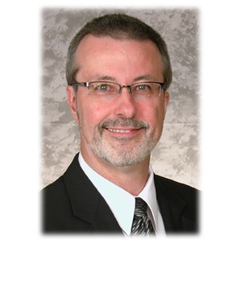
Mark Wright, OD, FCOVD
CEO: Practice Management Center
President: Pathways to Success
Editor: Review of Optometric Business
www.reviewofoptometricbusiness.com
Author: Coding, Reimbursement and Contracting for Optometry
Director: Bennett/VSP Business Management Program at TOSU
2006 Benedict Professor: University of Houston
1980 – 2007 founder: Professional VisionCare, Westerville, Ohio
Notes:
3
3
Dr. Wright is a 1980 graduate of The Ohio State University College of Optometry, where he is clinical assistant professor and faculty coordinator of OSU’s Business Management Program. Retired from practice last year, Dr. Wright is president of Pathways to Success, Eyecare Business Training and Progressive Publishing Company. All three of these companies are dedicated to the special practice management needs of eyecare practices. Dr. Wright has lectured extensively throughout the U.S. and abroad. His topics include not only practice management, but also managed care, sports vision and vision and traumatic brain injuries. He is also the practice management editor for the Journal of Optometric Vision Development. This is Mark’s first presentation to the MBA. Please welcome Mark Wright…

Slide 4
SPEAKER FINANCIAL DISCLOSURE STATEMENT
Mark R. Wright, OD, FCOVD has been a paid speaker for the following companies:
Alcon
B&L
ESSILOR
Jobson
Vistakon
VSP
He is an officer of:
Pathways to Success
Practice Management Center
Progressive Publishing Company
He is the professional editor of:
Review of Optometric Business
Diversified Ophthalmics
Eye Recommend
IDOC
IVA
PERC
Vision Source

Slide 5
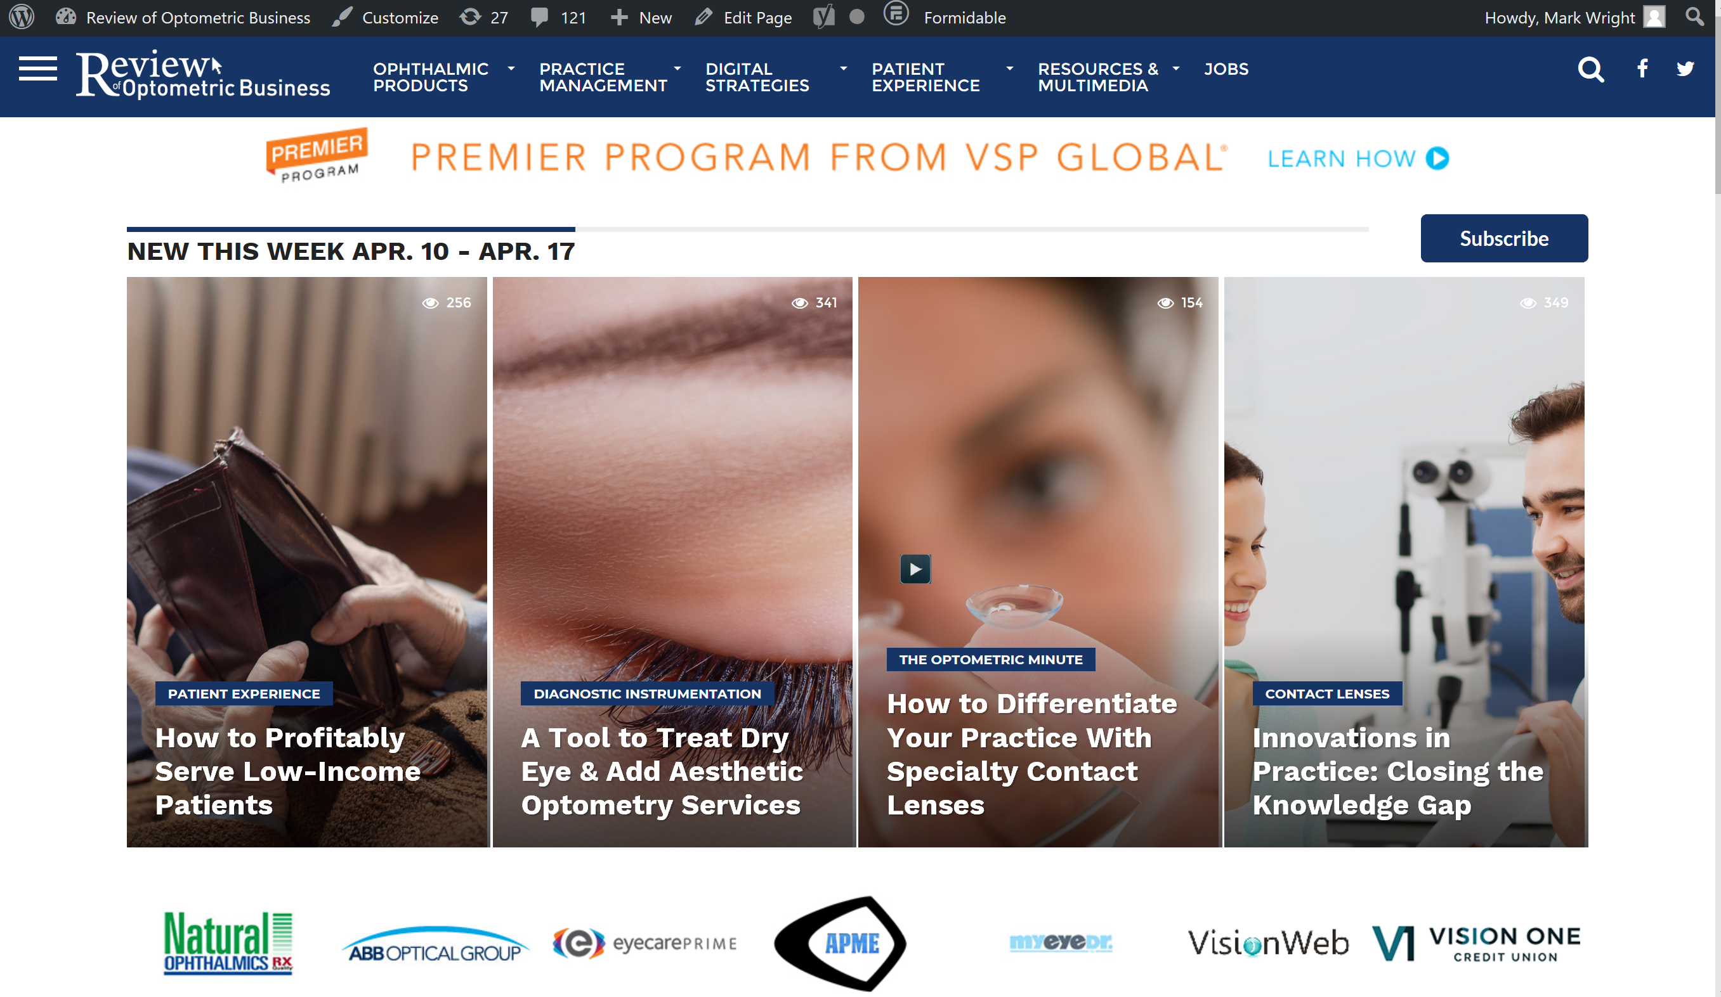
reviewob.com

Slide 6
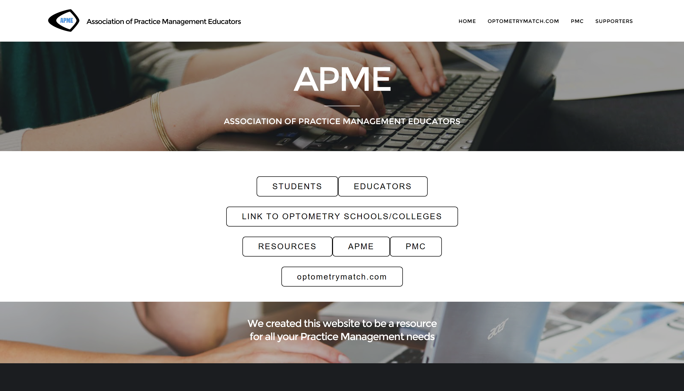
optometrybusiness.com

Slide 7
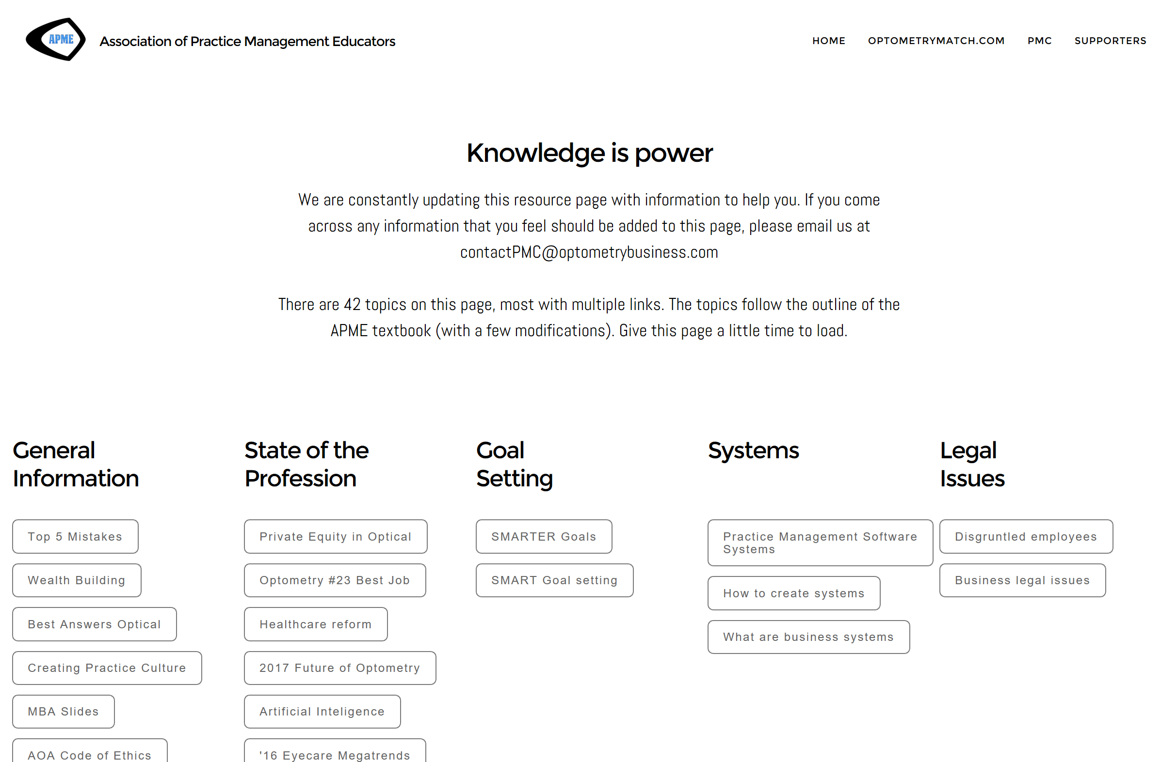

Slide 8
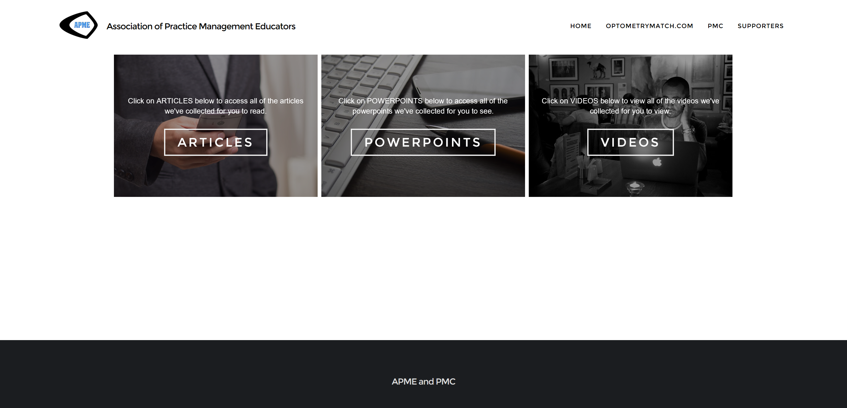

Slide 9
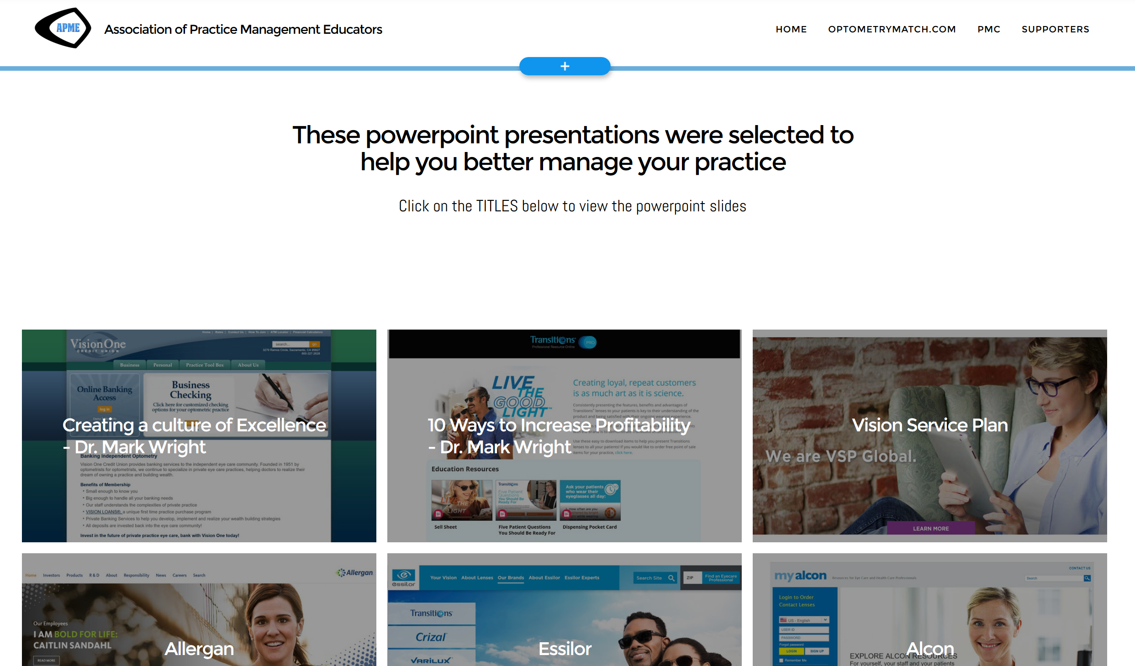

Slide 10
Course Objectives
The attendee will be able to ...
Increase your personal productivity
Increase income
Increase your ROI on marketing
Decrease COG expenses
Decrease Payroll expenses
Decrease Overhead expenses
Create Profit Centers
Actively manage by the numbers
Manage risk
Understand and manage money

Slide 11
Course Description
Every business can be thought of as an engine that creates profit. How well the practice creates profit is a function of how well the practice is being managed. This course teaches you how to manage the 10 most important ways to increase profitability in the practice.

Slide 12
Define and calculate profitability

Slide 14
Definition of 'Profit‘ Investopedia
“A financial benefit that is realized when the amount of revenue gained from a business activity exceeds the expenses, costs and taxes needed to sustain the activity. Any profit that is gained goes to the business's owners, who may or may not decide to spend it on the business.”

Slide 15
How to calculate PROFIT
Money IN
Money OUT
Money LEFT OVER

Slide 16
Money IN
Services
Exams
Specialty Services
Products
Glasses
CLs
Other

Slide 17
Money OUT

Slide 18
CATEGORIES | DEFINITION | RANGE | YOUR BUDGET
MONEY IN
Revenue | Money actually collected CLINICAL SERVICES MATERIALS OTHER | $640 - $1.4M | $700K then $1M, then $1.4M per FTE OD
MONEY OUT
COGS | MATERIALS Lab bills + All in-house lab costs | 23.9% - 34.2% | 25%
Staff Payroll | All costs for having staff | 15.5% - 24.2% | 20%
Occupancy | Occupying your space | 4.4% - 8.9% | 7%
Equipment | Clinical equipment | 0.2% - 3.4% | 1%
Marketing | Internal and external marketing | 0.6% - 2.3% | 1%
Overhead | Everything not covered above | 3.3% - 10.3% | 10%
MONEY LEFT
Dr Payroll | Costs for doctors | Ave = 15 – 17% | 20%
True Net | What is left over |  | 16%
Opto-Net | Dr Payroll + True Net |  | 36%

Slide 19
Is profit in your practice intentional or accidental?

Slide 20
Identify the 10 ways to increase profitability

Slide 21
10 ways to increase profitability
Stop sorting sand – increase your personal productivity
Increase income
Increase your ROI on marketing
Decrease COG expenses
Decrease Payroll expenses
Decrease Overhead expenses
Create Profit Centers
Actively manage by the numbers
Manage risk
Understand and manage money

Slide 22
10 ways to increase profitability
Stop sorting sand – increase your personal productivity
Increase income
Increase your ROI on marketing
Decrease COG expenses
Decrease Payroll expenses
Decrease Overhead expenses
Create Profit Centers
Actively manage by the numbers
Manage risk
Understand and manage money

Slide 23
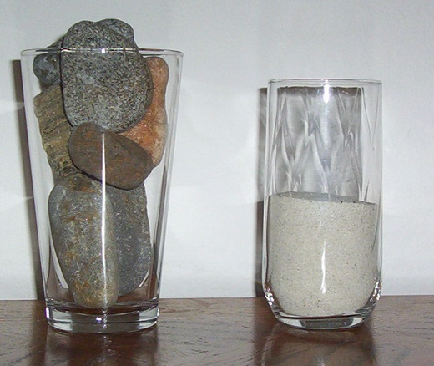
#1

Slide 24
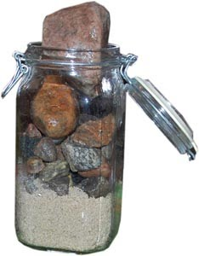
Stop sorting sand Make a master list
ROCKS SAND

Slide 25
Educator
Husband
CEO
Editor
Parent
Investor

Slide 26
Fiscal health
Risk management
Practice administration
Future planning
CEO

Slide 27
CEO – Practice Administration
Human relations
Hiring and Training
HR Reporting and Management
Firing
Procurement
Equipment
Clinic Supplies
Inventory
Information Technology
Computer System
Telephone System
E-Mail and Website Management
Operations
Scheduling
Examination
Treatment and Dispensing
Finance
Revenue
Expenses
Tax Reporting
Quality Control
Staff Proficiency Testing, Education and Discipline
Patient Quality Control
Laboratory Quality Control
Public Relations
Internal Marketing
External Marketing
Success Stories

Slide 28
Once a week for 30 minutes
Schedule your big rocks
Prioritize your master list (sand)
Daily, spend 10 minutes to plan your day

Slide 30
10 ways to increase profitability
Stop sorting sand – increase your personal productivity
Increase income
Increase your ROI on marketing
Decrease COG expenses
Decrease Payroll expenses
Decrease Overhead expenses
Create Profit Centers
Actively manage by the numbers
Manage risk
Understand and manage money

Slide 31
Increase income
#2
Increase fees
Increase income/pat
Increase new pats
Increase visit freq

Slide 32
Increase fees On things not covered by 3rd parties

Slide 33
Increase your income/patient

Slide 34
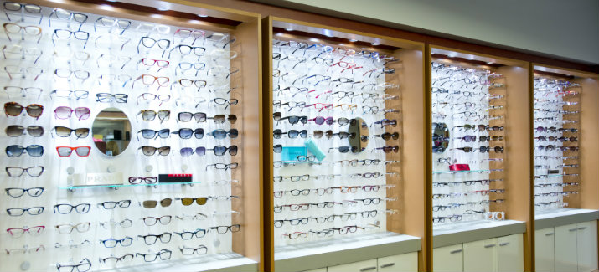

Slide 36
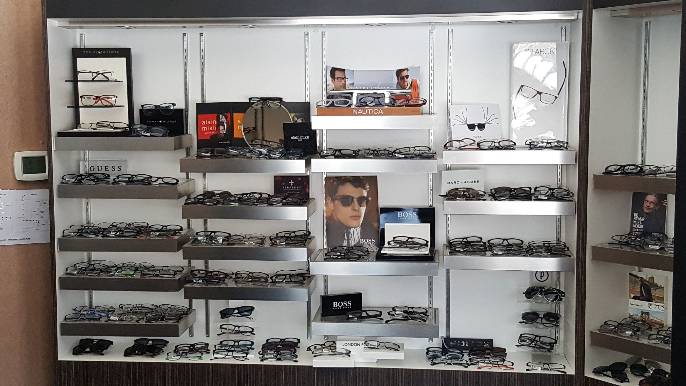

Slide 37
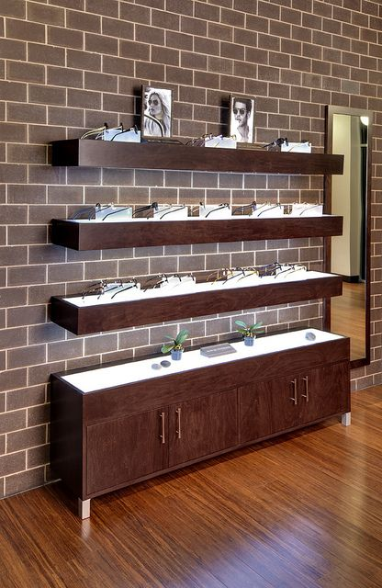

Slide 38
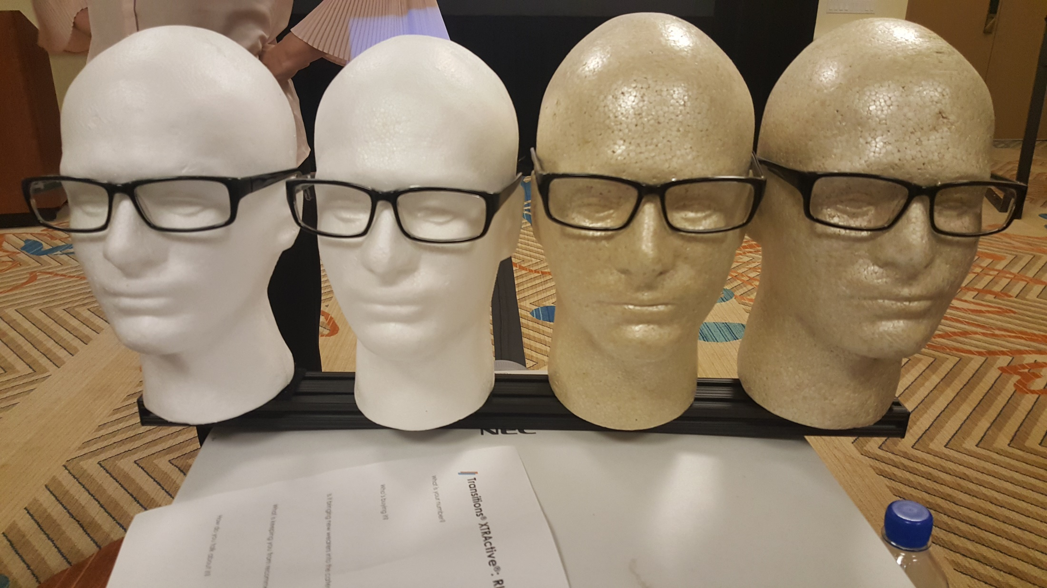

Slide 40
Visual Merchandising
People enter your office with the intention of purchasing
Effective visual merchandising guides them through their shopping journey
More than 80% of people have difficulty finding what they need due to ineffective merchandising
Many patients leave without fulfilling their desire to purchase

Slide 41
Visual Merchandising
Your optical should be a treasure hunt for the patient drawing them in to discover more
1
Patients are expecting newness – How often do you change your optical?
2

Slide 42
Newness
Floor rotation
1
Lifestyle
2
Images
3
Seasons
(Remove expired material)
4
Sensory
5
Smells
Sounds
Bright colors

Slide 43
3 keys to a great optical
The space is easy to shop in
The product is simple to find
The signage is clear and informative

Slide 44
Visual Merchandising Rules
DO’s
Light to Dark
Top to Bottom
Left to Right
Front to Back
DON’Ts
Don’t violate the Do’s
Don’t put like shapes together
Rimless
Aviators

Slide 45
How should your frames be arranged? Your frame reps can help you with this
First, you need to establish product adjacencies before you can start to plan your floor layout
Which products sit next to each other
The patient should be guided from one product to the next
Strong product catagories and key brands, should be positioned in prime locations
Place the largest categories and key brands first
Create gaps between products to keep the patients’ attention

Slide 46
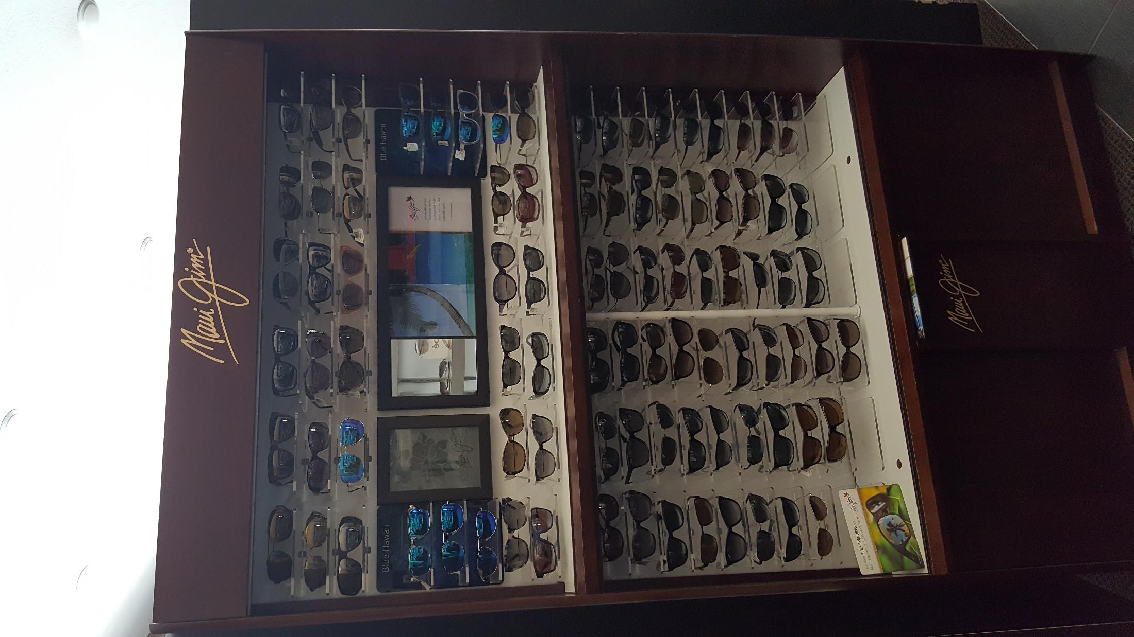
Brand Blocks Visual Merchandising Guidelines

Slide 47
POP Images should match the displays
Like images (eg: sun, rimless, metal) should be with like product
If not, it confuses the patient

Slide 48
Keep your logos updated

Slide 49
Frameboard Placement
HAT LEVEL (carry over/previous best sellers)
EYE LEVEL (best/advertised/hot style/new arrival)
HAND LEVEL (previously at EYE LEVEL)
GROUND LEVEL (slow movers/bread & butter)

Slide 50
How many frames to display
1,000 exams 450 - 550 frames
2,000 exams 600 - 700 frames
3,000 exams 700 - 900 frames
4,000 exams 900 - 1,200 frames
Marchon

Slide 51
4 Types of Patients
Image Patients
Buy product to acquire a better image, and believe that high cost and exclusivity add to a product's value. This is a very small but profitable group.
Quality Patients
Believe in quality and are willing to pay a premium for it. They often equate product quality with brand and technology, but absolutely require quality service. Treated right, this largest group of patients is the most loyal. They invest emotionally in you and usually won't switch for a few dollars.
Value Patients
Care about price but will pay more if the value they receive exceeds the price they feel it is worth. Value and quality patients will buy above the allowance on their Managed Care Plans for the right product and service.
Budget Patients
Hunt for the lowest price on everything they buy, even when it is inconvenient to do so. Their numbers are small and their contribution to profit is smaller. They will leave you to save a few dollars and don't buy above their plan.
Marchon

Slide 52
CLs
CL patients are more profitable over 10 years
CL patients need sunglasses
CL patients need back-up eyewear
CL patients need ocular surface care
EASE Study
Enhancing the Approach to Selecting Eyewear

Slide 53
CLs
62.5%

Slide 54
CLs
On a scale of 1 to 10
How do your CLs feel when you put them in?
How do your CLs feel with you remove them?

Slide 55
Increase # of New Patients

Slide 56
Increase Visit Frequency
Follow medical protocols
Pre-appoint with Solution Reach

Slide 57
10 ways to increase profitability
Stop sorting sand – increase your personal productivity
Increase income
Increase your ROI on marketing
Decrease COG expenses
Decrease Payroll expenses
Decrease Overhead expenses
Create Profit Centers
Actively manage by the numbers
Manage risk
Understand and manage money

Slide 58
Increase your ROI on marketing
Create projects
Tips for Tracking
Measure
Most effective
#3

Slide 59
10 ways to increase profitability
Stop sorting sand – increase your personal productivity
Increase income
Increase your ROI on marketing
Decrease COG expenses
Decrease Payroll expenses
Decrease Overhead expenses
Create Profit Centers
Actively manage by the numbers
Manage risk
Understand and manage money

Slide 60
Decrease COG expenses
#4
Alliance/buying group
Buy in bulk
Buy stock lenses
Manage inventory
Manage shrinkage

Slide 61
10 ways to increase profitability
Stop sorting sand – increase your personal productivity
Increase income
Increase your ROI on marketing
Decrease COG expenses
Decrease Payroll expenses
Decrease Overhead expenses
Create Profit Centers
Actively manage by the numbers
Manage risk
Understand and manage money

Slide 62
Manage Staff Payroll Effectively
#5
Have the correct number of staff
Paid at the correct level
Each staff member is productive

Slide 63
Utilize staff to help in management

Slide 64
Make sure every staff member knows what they produce
Doctor: Tx plans completed
Recall: Kept appointments
Optician: Jobs dispensed

Slide 65
Train staff to be managers Managing Profit Centers
Efficient
Effective

Slide 66
Top 10 Reasons Why Employees Quit Their Jobs
Relationship with boss
Bored and unchallenged by the work itself
Relationships with co-workers
Opportunities to use skills and abilities
Contribution of work to the organization’s business goals
Autonomy and independence
Meaningfulness of job
Organization’s financial stability
Overall corporate culture
Management’s recognition of employee job performance
https://www.thebalance.com/top-reasons-why-employees-quit-their-job-1918985

Slide 67
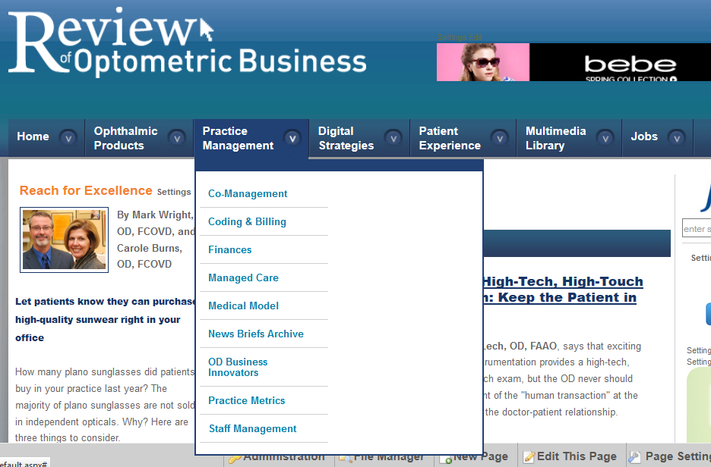
www.reviewob.com

Slide 68
Have the correct number of staff
Total staff hours worked / 1 FTE staff
Total gross revenue / $140,000
$500,000 / $140,000 = 3.6 FTE
$1M / $140,000 = 7.14 FTE
But … $1 M / 6.5 FTE = $153,846

Slide 69
Paid at the correct level
$500K x 20% = $100,000
$1 M x 20% = $200,000

Slide 70
Jobson ECP Compensation Study

Slide 71
Helpful Websites
https://www.bls.gov/oes/current/oes292081.htm
Payscale.com
Indeed.com
Salary.com
Glassdoor.com

Slide 72
Each staff member is productive
Practice Number | Staff member | How measured
Gross revenue
Total number of patients seen
Total number of new patients
Total Accounts Receivable
AR over 30 days
% of 2nd pair sales
Capture rate

Slide 73
10 ways to increase profitability
Stop sorting sand – increase your personal productivity
Increase income
Increase your ROI on marketing
Decrease COG expenses
Decrease Payroll expenses
Decrease Overhead expenses
Create Profit Centers
Actively manage by the numbers
Manage risk
Understand and manage money

Slide 74
#6

Slide 75
Equipment

Slide 77
10 ways to increase profitability
Stop sorting sand – increase your personal productivity
Increase income
Increase your ROI on marketing
Decrease COG expenses
Decrease Payroll expenses
Decrease Overhead expenses
Create Profit Centers
Actively manage by the numbers
Manage risk
Understand and manage money

Slide 78
To make sure each part of the practice is pulling its weight, divide the practice into Profit Centers

Slide 79
Create Profit Centers
#7
Clinic
Optical
Money IN
- Money OUT
Money REMAINING
Money IN
- Money OUT
Money REMAINING

Slide 80
Create Profit Centers
Money IN
- Money OUT
Money REMAINING
CLINIC
Money IN
- Money OUT
Money REMAINING
EYEWEAR
CLs
Money IN
- Money OUT
Money REMAINING
Money IN
- Money OUT
Money REMAINING
VT

Slide 81
Profit Center: CLs
Profit & Loss Statement
Jan through Dec 2018
Income
Self Pay
3rd Party
Expenses
COGS
Doctor Payroll
Staff Payroll
Occupany
Clinical Equipment
Marketing
Overhead
Net Income (Loss)

Slide 82
How do I assign income & expenses
Profit Center: CLs
Profit & Loss Statement
Jan through Dec 2018
Income
Self Pay
3rd Party
Expenses
COGS
Doctor Payroll
Staff Payroll
Occupany
Clinical Equipment
Marketing
Overhead
Net Income (Loss)
Profit Centers
Clinic
Glasses
CL
Dry Eye
VT
LV

Slide 83
10 ways to increase profitability
Stop sorting sand – increase your personal productivity
Increase income
Increase your ROI on marketing
Decrease COG expenses
Decrease Payroll expenses
Decrease Overhead expenses
Create Profit Centers
Actively manage by the numbers
Manage risk
Understand and manage money

Slide 84
Create or Buy a Reporting System
#8

Slide 85
CPA/Accountant

Slide 86
Excel

Slide 87
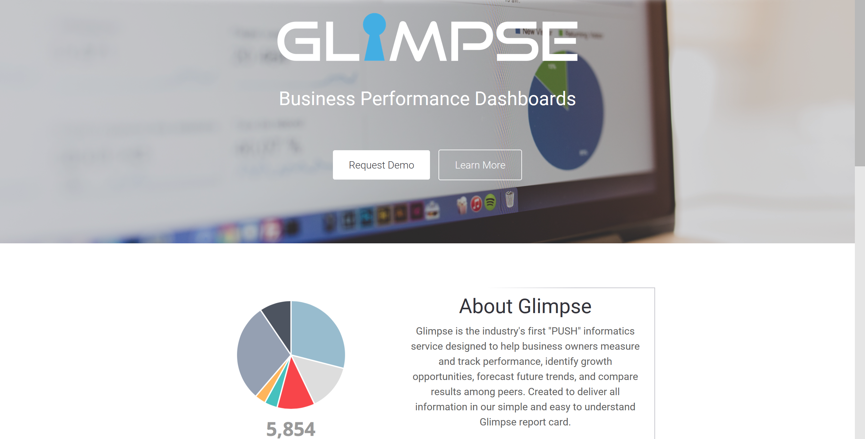
https://www.glimpselive.com/index.html

Slide 88
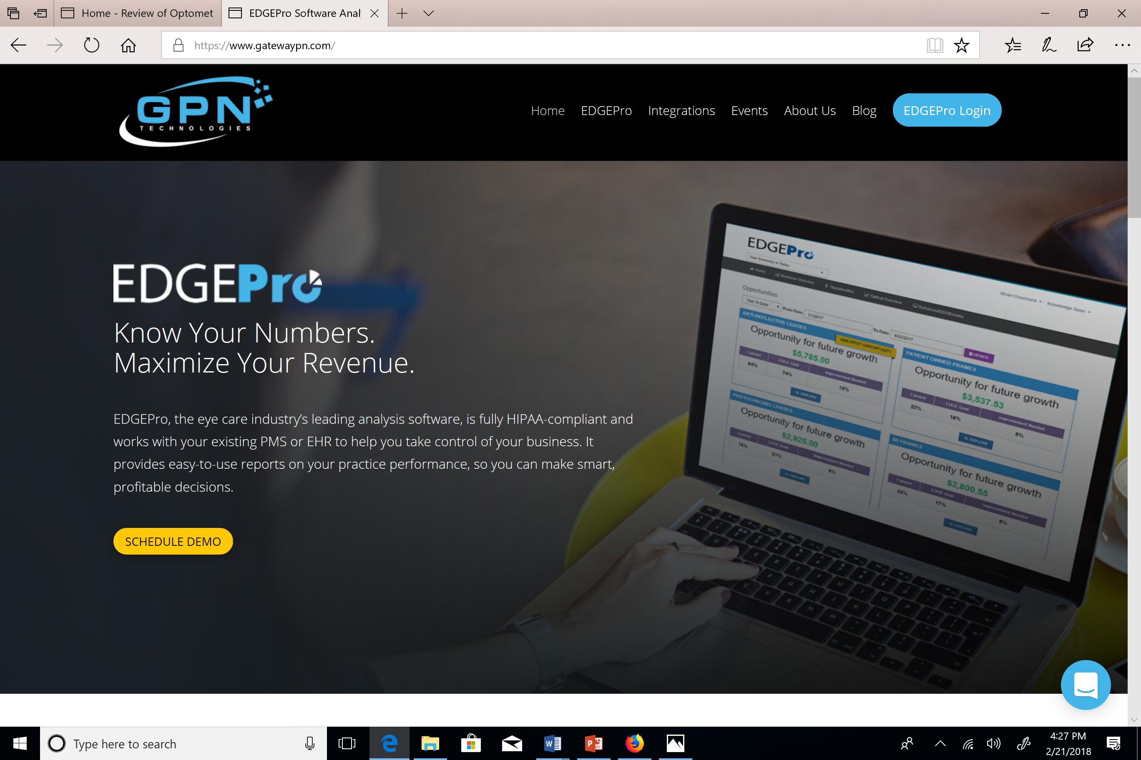
https://www.gatewaypn.com/

Slide 89
Actively manage by the numbers
Yearly goals
Weekly review
Daily tracking

Slide 90
Create a system for managing the trends

Slide 91
Office Meetings
TYPES
Daily huddle
Weekly meeting
Quarterly meeting
Annual meeting
FORMAT
Control level
Action plan
How can we help

Slide 92
10 ways to increase profitability
Stop sorting sand – increase your personal productivity
Increase income
Increase your ROI on marketing
Decrease COG expenses
Decrease Payroll expenses
Decrease Overhead expenses
Create Profit Centers
Actively manage by the numbers
Manage risk
Understand and manage money

Slide 93
Manage risk
#9
Disability Insurance
Exit Strategy
Vertical
Horizontal
25 documents everyone MUST have

Slide 94
Marriage and Divorce
Marriage license
Divorce papers
Life Insurance and Retirement
Life insurance policies
Individual retirement accounts
401(k) accounts
Pension documents
Annuity contracts
Healthcare
Personal and family medical history
Durable healthcare power of attorney
Authorization to release healthcare information
Living will
Do not resuscitate order
Bank Accounts
List of bank accounts
List of all user names and passwords
List of safe deposit boxes
Proof of Ownership
Housing, land and cemetery deeds
Escrow mortgage accounts
Proof of loans made and debts owed
Vehicle titles
Stock certificates, saving bonds and brokerage accounts
Partnership and corporate operating agreements
Tax returns
Essential Documents
Will
Letter of instruction
Trust documents

Slide 95
10 ways to increase profitability
Stop sorting sand – increase your personal productivity
Increase income
Increase your ROI on marketing
Decrease COG expenses
Decrease Payroll expenses
Decrease Overhead expenses
Create Profit Centers
Actively manage by the numbers
Manage risk
Understand and manage money

Slide 96
Understand and manage money Rich Dad, Poor Dad … E-Myth Physician
#10
4 Different Type of Money
Income (Active)
Most or Least important?
Profit (Passive)
Intentional or Accidental?
Cash Flow
How $ moves through practice
Equity (Passive)
Practice Scorecard
Passive vs Active Income
Active Income
Passive Income
Financial Freedom

Slide 97
10 ways to increase profitability
Stop sorting sand – increase your personal productivity
Increase income
Increase your ROI on marketing
Decrease COG expenses
Decrease Payroll expenses
Decrease Overhead expenses
Create Profit Centers
Actively manage by the numbers
Manage risk
Understand and manage money

Slide 98
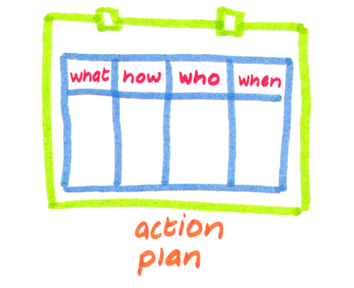

Slide 99
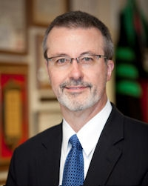
Thank you !
Mark Wright, OD, FCOVD
mwright@pathways-o.com
Put Vision Trends in the SUBJECT Line

